Slide 1
Machine Problem #1

Slide 2
RULES OF DAMA

Slide 3
Rules of Dama
Dama is played on an 8x8 board. Each player starts with 12 men on his second and third ranks. The light color moves first, and players take turns.
The winner is the last player to complete a legal move. Normally a player loses when all of his pieces are captured, thus leaving him with no legal moves. But a player also loses if his remaining pieces have no legal moves.
Men move 1 space straight forward or sideways. They may jump in the same directions over an adjacent piece to an empty space immediately beyond. The piece which is jumped over is captured. A series of jumps with the same piece may be done in a single turn.

Slide 4
Rules of dama
When a man ends its turn on the far row of the board it is "crowned" and becomes a King.
Kings move any number of spaces horizontally or vertically, and may jump in the same manner, jumping over a single piece and landing in any empty square beyond.
If a player has jumps available, he must jump. If a piece can continue jumping, it must. If a player has a choice of jumps he must choose the series of jumps which captures the most pieces.

Slide 5
Machine problem #1

Slide 6
Machine problem #1
Write a Java GUI program that would simulate a Dama game, taking into consideration the rules stated above.

Slide 7
When making multiple jumps, unlike Checkers or Draughts, each piece is captured and removed from the board as it is jumped. It is also illegal to make a 180 degree turn when jumping.
When the diagonal option is in effect, men move 1 space forward, sideways, or diagonally forward. Kings move and jump in any direction, horizontally, vertically, or diagonally.

Slide 8
Class Diagram

Slide 9
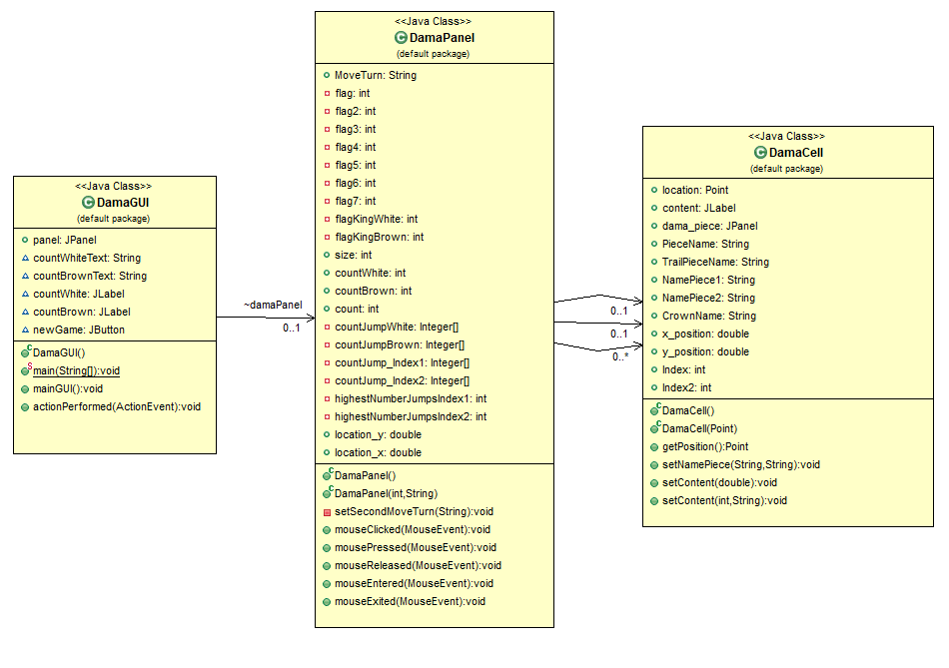

Slide 10
User interface design

Slide 11
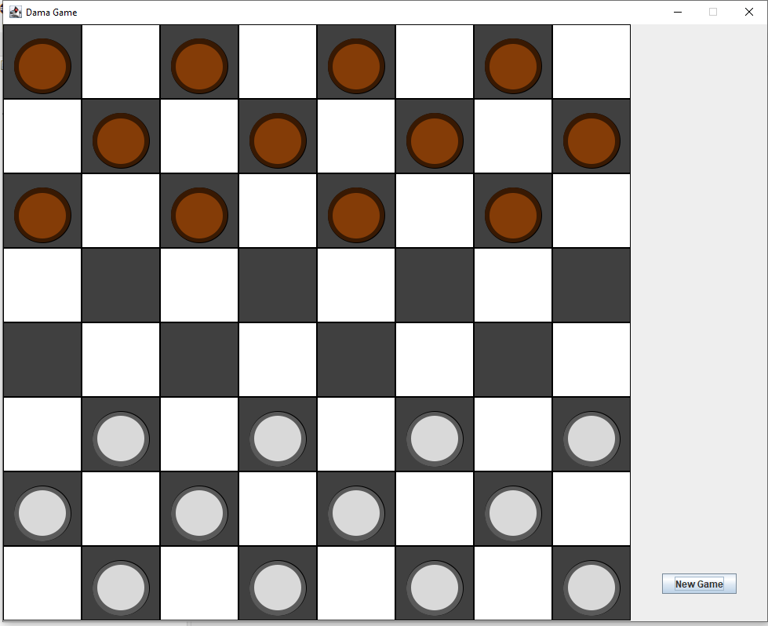

Slide 12
Formula for determining the location of a specific cell

Slide 13
formula
(y*size)+x
(y*size)+x-2*(size+1)
(y*size)+x-2*(size-1)
(y*size)+x+2*(size-1)
(y*size)+x+2*(size+1)

Slide 14
 | 0 | 1 | 2 | 3 | 4 | 5 | 6 | 7
0
1 |  | * |  | *
2 |  |  | 0
3 |  | * |  | *
4
5
6
7
(y*size)+x
(y*size)+x-2*(size+1)
(y*size)+x-2*(size-1)
(y*size)+x+2*(size-1)
(y*size)+x+2*(size+1)

